Slide 1
Heterogeneous Memory Management
Neha Agarwal
December 18, 2015
Thesis Proposal
Notes:
Hi Everyone, I am Neha ☺
First, I want to thank you all for being in my Dissertation committee. Let’s begin.
Today, I am going to propose my thesis on Heterogeneous Memory Management.

Slide 2
Conventional Memory Hierarchy
CPU
GPU
Memory (DDR)
Memory (GDDR)
Notes:
As computers have evolved we have heterogeneity in both memory technology type and core types.
Let’s see how a conventional memory hierarchy looks like for a CPU and a GPU.
On the left we have a cpu connected to multi-channel DDR type main memories. Here all these memory modules are same latency, bandwidth, and cost.
On the right we have a GPU, which conventionally accesses data only from on-board graphics memory for achieving high throughput.
For further enhancements to performance, programmability and reducing the overall cost of owning a computing systems, there have been several developments on the new memory technology types as well as on how the memory hierarchy is arranged. Lets look at those trends and examples of upcoming heterogeneous systems.

Slide 3
Heterogeneous Memory Systems
↑ Bandwidth
GPU
Memory
(GDDR)
Opportunity:
Simplify GPU programming
without sacrificing performance
Different Coherence Domain
Memory
(DDR)
Notes:
Conventionally, GPU programmers have to deal with 2 separate address spaces to achieve highest level of performance that is on-board GDDR address space and CPU attached DDR address space. However, future GPU systems are going to have high speed interconnect between CPU and GPU enabling a cache-coherent unified view of memory. Such a system is heterogeneous from two aspects. First the bandwidth differential between GDDR and DDR ranging between 2-8x. Second, they lie in different coherence domain.
In such a system we explore how to achieve highest performance without hurting programmability.

Slide 4
Heterogeneous Memory Systems
CPU
Memory
(DDR)
XPoint: 2-5x Cheaper, 4-10x Slower
Opportunity: Lower system cost
↓ Latency
Memory
(XPoint)
↓ Cost per bit
Notes:
In the CPU space we see a similar trend.
Conventionally where a CPU is only attached to one type of memory that is DDR, soon we will have an option of putting a cheaper memory technology into the system potentially lowering the overall cost. Intel and Micron recently announced their XPoint memory technology that is projected to be 2-5x cheaper than regular DRAMs. However, the catch is they will be 4-10x slower than the DRAMs we use today. Because XPoint is slower than the DRAM, it will not replace DRAM completely, but there is an opportunity to deploy these cheaper but slower memories in data-center and bring the overall cost down.

Slide 5
Heterogeneous Memory Systems
↑ Bandwidth
GPU
CPU
Memory
(GDDR)
Memory
(DDR)
↓ Latency
Different Coherence Domain
Memory
(DDR)
Memory
(XPoint)
↓ Cost per bit
New memories for performance & programmability, cheaper systems
Notes:
So, overall we have differences in memory latency, bandwidth, cost/bit, and coherence domains bringing heterogeneity to these systems.

Slide 6
Memory Management has been...
Core
Memory
Optimized for latency
Notes:
Memory management in existing heterogeneous memory systems has been studied but mainly focusing on minimizing memory access latency. For example, NUMA placement policies try to place data near to the core it will be accessed from.

Slide 7
Wait, but...
What about bandwidth to my GPU?
Core
Memory
Optimized for latency
What about cost/bit in my data-center?
Notes:
However, in upcoming heterogeneous systems other characteristics like bandwidth, cost/bit need to be considered.

Slide 8
My Thesis
Bandwidth
Coherence Domain
Cost/bit
Memory management considering differences in memory technologies
Application transparent
Dynamic decisions at runtime
Notes:
In this thesis, I have studied these heterogeneous systems from 3 perspectives: maximizing bandwidth, simplifying coherence implementations, and minimizing cost/bit. While designing memory management policies I have taken into cinsideration two constraints.
First, these policies should be application transparent to reduce the overhead of porting already existing code.
Second, they should dynamically adapt to the application runtime behavior.

Slide 9
My Contributions
BW-AWARE placement for bandwidth maximization in GPUs, +35% performance over Linux Interleave placement (ASPLOS’15)
Dynamic page migration for GPU with range expansion and bandwidth balancing, +6% performance over Legacy CUDA (HPCA’15)
Selective Caching for CC-NUMA CPU-GPU systems to simplify coherence, 93% of hardware cache-coherent performance (HPCA’16)
Notes:
In this proposal, I make 3 contributions:
First, I propose bw-aware page placement policy that improves GPU throughput by 35% by maximizing bandwidth utilization.
Second, to improve programmability of GPUs, I propose a dynamic page migration policy that eliminates memcopies while still being faster than Legacy CUDA.
Third, to simplify CPU-GPU shared virtual memory implementation, I propose selective caching for GPUs that eliminates the need of CPU-GPU HW cache coherence while achieving 93% of the performance.

Slide 10
Proposal: Thermostat
Huge-page-aware, application-transparent data placement in 2-tiered memory systems
Notes:
As the next part of my thesis I propose "Thermostat" - a system to enable usage of huge pages in heterogeneous memory systems in data-centers. We will discuss more about this in the later part of my talk.

Slide 11
Talk Outline
Bandwidth maximization in GPUs
Rethinking CPU-GPU Cache Coherence
Proposal: Thermostat
Notes:
I have divided rest of my talk into 3 sections.
First, I will briefly talk about data management policies to maximize bandwidth utilization in GPU based systems
Second, I will discuss selective caching policy for GPUs enabling the elimination of cache coherence implementation complexity
Finally, I will propose huge page aware 2 tier memory management system which I call Thermostat

Slide 12
Bandwidth Maximization in GPUs
Agarwal, N., Nellans, D., O'Connor, M., Keckler, S. W., & Wenisch, T. F. (2015, February). Unlocking bandwidth for GPUs in CC-NUMA systems. In High Performance Computer Architecture (HPCA), 2015 IEEE 21st International Symposium on (pp. 354-365).
Agarwal, N., Nellans, D., Stephenson, M., O'Connor, M., & Keckler, S. W. (2015, March). Page Placement Strategies for GPUs within Heterogeneous Memory Systems. In Proceedings of the Twentieth International Conference on Architectural Support for Programming Languages and Operating Systems (pp. 607-618).
Notes:
So, lets start with policies maximizing bandwidth in GPUs

Slide 13
GPU Workloads: Memory Bandwidth Sensitive
Applications perform up to 2.8x better with 3x more BW
Notes:
So, why is bandwidth so important for GPUs? GPUs are designed to have 100s of concurrent threads executing in parallel to hide memory latency making then highly sensitive to memory bandwidth. Here in this graph we vary DRAM bandwidth and observe the corresponding throughput achieved for several GPU applications from Rodinia, Parboil etc. We can see that performance increases by around 3x with increase in bandwidth by 3x.
Hence, it is imperative to exploit as much BW as possible in order to get the best possible performance for most of the GPU workloads.

Slide 14

GPU Bandwidth Utilization
280
GPU
NVLink
DDR4
80 GB/s
200
Total Bandwidth (GB/s)
200 GB/s
80
DDR4 BW
GDDR5
70
0
100
% of Pages in GPU Memory
Coherence-based accesses, wastes GPU memory BW
Notes:
Let's look at how to maximize memory bandwidth to the GPU in a heterogeneous memory system.
On the left, we have a GPU attached to its own high bandwidth GDDR memory. It is also connected to the CPU-attached DDR memory through a high bandwidth cache-coherent interconnect such as NVLink ,which enables it to directly access the DDR memory.
On the right, we see the total bandwidth available to the GPU as we vary the fraction of data placed in these memories.
When all the data is only in DDR memory the available BW is only from the cache coherent interconnect which is 80GB/sec. This scheme does not utilize high bandwidth GDDR at all.

Slide 15
GPU Bandwidth Utilization
280
GPU
NVLink
DDR4
80 GB/s
200
GDDR5 BW
Total Bandwidth (GB/s)
200 GB/s
80
DDR4 BW
GDDR5
70
0
100
% of Pages in GPU Memory
Excessive data in GDDR leads to under-utilization of DDR BW
Notes:
Now, let's consider the scheme in which all the data is placed only in GDDR5 memory. Although available memory bandwidth is greater than DDR bandwidth only, still this scheme wastes DDR memory bandwidth.

Slide 16
GPU Bandwidth Utilization
Total System Memory BW
280
GPU
NVLink
DDR4
80 GB/s
200
GDDR5 BW
Total Bandwidth (GB/s)
200 GB/s
80
DDR4 BW
GDDR5
70
0
100
% of Pages in GPU Memory
Bandwidth-Aware Placement
Place data in the ratio of memory bandwidths
Notes:
However, there is a middle ground. It can be proven that the optimal placement scheme is the one that places data in the ratio of memory bandwidths of different memory technologies. So, in our example system the optimal data placement ratio is 70% in GDDR5 memory, which fully utilizes memory bandwidth from both the technologies. We call this technique as BW-Aware placement policy.

Slide 17
BW-AWARE Placement Performance
Rodinia, Parboil and DoE mini apps
35% better than INTERLEAVE, 18% better than LOCAL
BW-AWARE placement maximizes GPU throughput
Notes:
We can see here that BW-AWARE placement performs better as compared to existing NUMA placement policies

Slide 18
Rethinking CPU-GPU Cache Coherence
Agarwal, N., Nellans, D., Ebrahimi, E., Wenisch, T. F., Danskin, J., & Keckler, S. W. (2016, March). Selective Caches in GPUs to Eliminate Cache Coherence. To appear in High Performance Computer Architecture (HPCA), 2016 IEEE 22nd International Symposium.
Notes:
Let me now talk about how I eliminate the complexity of implementing CPU-GPU cache coherence.

Slide 19
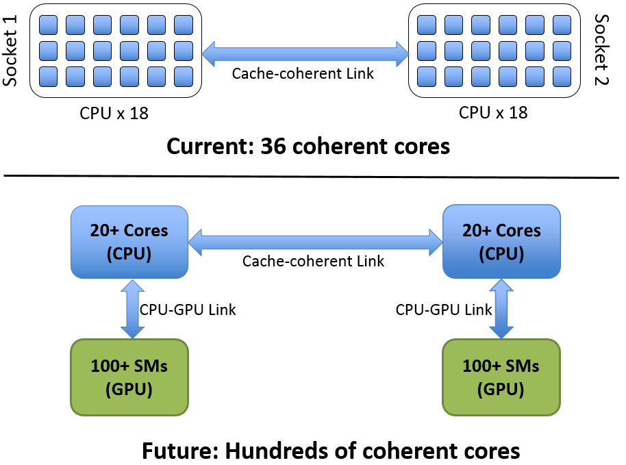
HW Cache Coherence: Liability for CPU-GPU Systems
Goal: Shared virtual address space with performance & programmability
Notes:
First let me describe the problem we are trying to solve here. As GPUs move towards globally visible shared memory, there is a design challenge in keeping 100s of cores coherent. Shared virtual memory improves programmer productivity by eliminating explicit copies and memory management overheads. However, implementing cache coherence between 10s of CPU cores and 100s of GPU cores is a significant design challenge, even more so due to the level of communication required between different CPU and GPU vendors. So, our goal is to simplify the system design which maintains the programmability of cache-coherent CPU-GPU system while not sacrificing performance.

Slide 20
Selective Caching for GPUs
Provides unified shared memory w/o HW cache-coherence
CPU and GPU need not implement same coherence protocol
Micro-architectural enhancements to make system performant
Notes:
So, I propose selective caching in GPUs that does not need CPU and GPU vendors to agree on a common cache coherence protocol while presenting globally visible shared memory to the programmer. In order to make this system at par with hardware cache-coherent performance I will discuss a few micro-architectural techniques.

Slide 21

Principles Of Selective Caching
CPU caches all memory
GPU never caches CPU-memory
GPU caches GPU-memory if CPU not caching
CPUs
DDR4
DDR4
DDR4
Directory
DDR4
GPU reads DDR:
DIR sends most recent copy
GPU does not need to handle coherence traffic due to CPU updates
CPU caching capability remains intact
GPU writes DDR:
DIR handles invalidation of CPU caches
CPU reads/writes GDDR:
Line inserted in Remote Directory (Filter) GPU can’t cache lines found in this filter
GDDR5
GDDR5
GDDR5
GDDR5
GDDR5
Remote Directory
GDDR5
GPU
GDDR5
GDDR5
Notes:
The principle behind Selective Caching is simple: the GPU never caches what the CPU can potentially cache. The CPU is, however, free to cache all memory. Since the CPU and GPU never cache the same memory location, a cache coherence protocol is not required.
In order to provide these guarantees, we follow two strategies. First, GPU does not cache any data from CPU attached DDR memory. Second, we have a Remote Directory structure in the GPU, which stores the set of lines ever touched by the CPU from the GDDR memory. The GPU consults the remote directory before caching any line. If a line has been touched by the CPU, the GPU does not cache it.
Also, the CPU needs to implement a directory which invalidates all cached copies of a line whenever the GPU writes to that line. These two hardware structures ensure the coherence of data between CPU and GPU, while also ensuring that the CPU and GPU does not need to agree on a common cache coherence protocol.

Slide 22
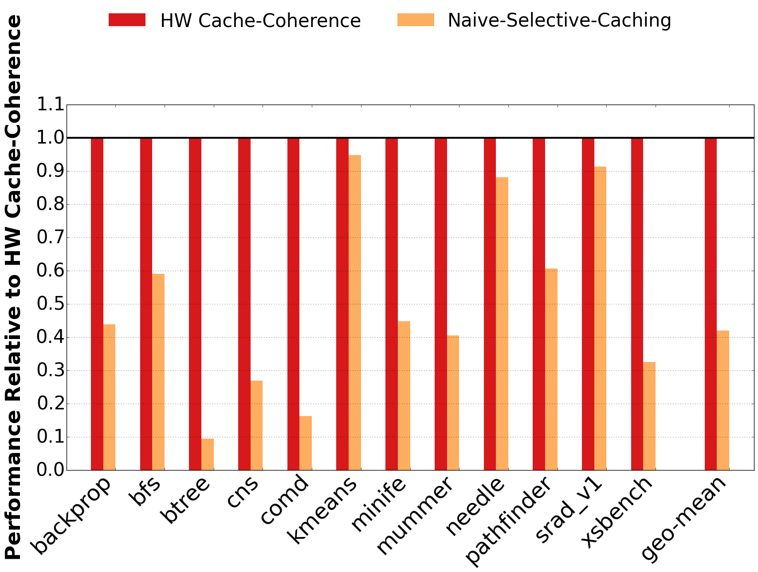
Naïve Selective Caching
CPU caches all memory
GPU never caches CPU-memory
GPU caches GPU-memory if CPU not caching
CPUs
DDR4
DDR4
DDR4
Directory
DDR4
GPU reads DDR:
DIR sends most recent copy
GPU writes DDR:
DIR handles invalidation of CPU caches
CPU reads/writes GDDR:
Line inserted in Remote Directory (Filter) GPU can’t cache lines found in this filter
GDDR5
GDDR5
GDDR5
GDDR5
GDDR5
Remote Directory
GDDR5
GPU
GDDR5
GDDR5
Achieves 40% performance only
Notes:
If we see the performance of this scheme in the case where the data is distributed in the optimal 70-30 ratio, we can see that it performs significantly worse than hardware coherence, primarily because of the fact that the GPU now can not cache 30% of the data, leading to excessive memory requests to the DDR memory. It achieves only 40% of the performance of the hardware-cache-coherent solution, which is not acceptable. So, next I propose a few micro-architectural techniques that can bridge this gap.

Slide 23
Request Coalescing
CPU caches all memory
GPU never caches CPU-memory
GPU caches GPU-memory if CPU not caching
CPUs
DDR4
DDR4
DDR4
Directory
DDR4
GPU reads DDR:
DIR sends most recent copy
Capture spatial locality
Reduce traffic to CPU memory
35% requests are coalesced
≈ 80% of L1-hits
GPU writes DDR:
DIR handles invalidation of CPU caches
CPU reads/writes GDDR:
Line inserted in Remote Directory (Filter) GPU can’t cache lines found in this filter
GDDR5
GDDR5
GDDR5
u
GDDR5
Remote Directory
GDDR5
Request Coalescer
GDDR5
GDDR5
Coalesces GPU requests to DDR
GDDR5
GPU
Notes:
The first technique is what we call Request Coalescing. In this technique, the GPU does not send extra requests to the DDR memory if there is an in-flight request to the same line in the MSHR in the GPU cache. The data returned from the DDR memory will be consumed and then discarded immediately and will not be cached. This captures most of the spatial locality present in the GPU access stream and reduces the number of requests to the slow DDR memory by ~ 35%, thereby increasing the GPU performance significantly.

Slide 24
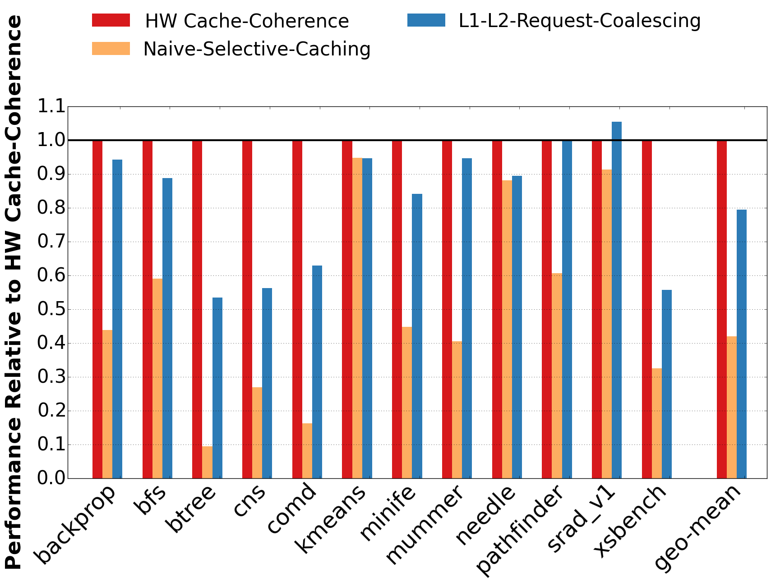
Request Coalescing
CPU caches all memory
GPU never caches CPU-memory
GPU caches GPU-memory if CPU not caching
CPUs
DDR4
DDR4
DDR4
Directory
DDR4
GPU reads DDR:
DIR sends most recent copy
GPU writes DDR:
DIR handles invalidation of CPU caches
CPU reads/writes GDDR:
Line inserted in Remote Directory (Filter) GPU can’t cache lines found in this filter
GDDR5
GDDR5
GDDR5
u
GDDR5
Remote Directory
GDDR5
Request Coalescer
GDDR5
GDDR5
Coalesces GPU requests to DDR
GDDR5
GPU
80% performance
Notes:
The figure on the right shows the performance of the request coalescing scheme in blue. We can see that with request coalescing alone, the performance is quite competitive with hardware cache coherence, being about 80% of the cache-coherent solution.

Slide 25
CPU-side Client Cache
CPU caches all memory
GPU never caches CPU-memory
GPU caches GPU-memory if CPU not caching
v
Reduces DDR traffic from the GPU
CPUs
DDR4
Client Cache
DDR4
DDR4
Directory
DDR4
GPU reads DDR:
DIR sends most recent copy
Capture temporal locality
Coherence traffic within CPU die only
GPU writes DDR:
DIR handles invalidation of CPU caches
CPU reads/writes GDDR:
Line inserted in Remote Directory (Filter) GPU can’t cache lines found in this filter
GDDR5
GDDR5
GDDR5
u
GDDR5
Remote Directory
GDDR5
Request Coalescer
GDDR5
GDDR5
Coalesces GPU requests to DDR
GDDR5
GPU
Notes:
As a second improvement, we then experiment with integrating a cache for GPU requested DDR data on the CPU die. We call this cache the client cache. The client cache helps by capturing the temporal locality within the GPU access stream, and better utilizing the DDR bandwidth by reducing stalls in the DDR memory due to DDR bank conflicts etc. Note that since this cache is within the CPU die, it can utilize the CPU domain coherence protocol, and the coherence protocols of the CPU and GPU need not be the same here.

Slide 26
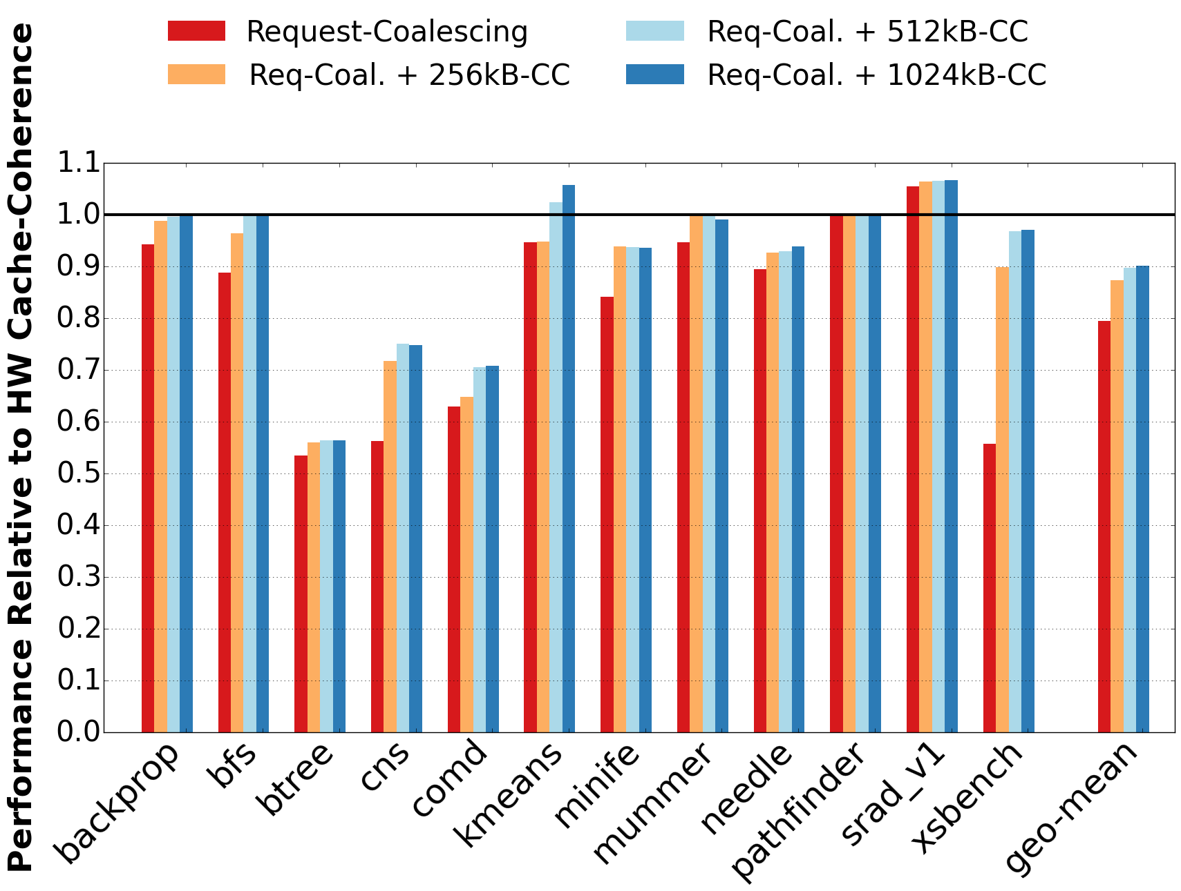
CPU-side Client Cache
CPU caches all memory
GPU never caches CPU-memory
GPU caches GPU-memory if CPU not caching
v
Reduces DDR traffic from the GPU
CPUs
DDR4
Client Cache
DDR4
DDR4
Directory
DDR4
GPU reads DDR:
DIR sends most recent copy
GPU writes DDR:
DIR handles invalidation of CPU caches
CPU reads/writes GDDR:
Line inserted in Remote Directory (Filter) GPU can’t cache lines found in this filter
GDDR5
GDDR5
GDDR5
u
GDDR5
Remote Directory
GDDR5
Request Coalescer
GDDR5
GDDR5
Coalesces GPU requests to DDR
GDDR5
GPU
90% performance
Notes:
When we see the performance of the client cache, we can see that a 1MB client cache can provide another 10% performance improvement over request coalescing, making the performance of our scheme 90% that of hardware cache coherence.

Slide 27
Variable Width Request Transfer
CPU caches all memory
GPU never caches CPU-memory
GPU caches GPU-memory if CPU not caching
v
Reduces DDR traffic from the GPU
CPUs
DDR4
Client Cache
DDR4
DDR4
Directory
DDR4
GPU reads DDR:
DIR sends most recent copy
w
GPU writes DDR:
DIR handles invalidation of CPU caches
60% cache line utilization
Transfer only the required bytes
Improves CPU-GPU interconnect efficiency
Variable-size Transfer
CPU reads/writes GDDR:
Line inserted in Remote Directory (Filter) GPU can’t cache lines found in this filter
GDDR5
GDDR5
GDDR5
u
GDDR5
Remote Directory
GDDR5
Request Coalescer
GDDR5
GDDR5
Coalesces GPU requests to DDR
GDDR5
GPU
Notes:
As a next improvement, we propose variable width transfers over the CPU-GPU interconnect, which enables using the interconnect more efficiently as only the required bytes are transferred over the interconnect This improvement is motivated by the observation that only 60% of requested cache line data is actually used by the GPU.
In this scheme, the GPU sends 32B sized requests to the client cache, which then merges as many responses as possible while serving a particular request. This merged response ensures the best utilization of the interconnect bandwidth.

Slide 28
Variable Width Request Transfer
CPU caches all memory
GPU never caches CPU-memory
GPU caches GPU-memory if CPU not caching
v
Reduces DDR traffic from the GPU
CPUs
DDR4
Client Cache
DDR4
DDR4
Directory
DDR4
GPU reads DDR:
DIR sends most recent copy
w
GPU writes DDR:
DIR handles invalidation of CPU caches
Improves CPU-GPU interconnect efficiency
Variable-size Transfer
CPU reads/writes GDDR:
Line inserted in Remote Directory (Filter) GPU can’t cache lines found in this filter
GDDR5
GDDR5
GDDR5
u
GDDR5
Remote Directory
GDDR5
Request Coalescer
GDDR5
GDDR5
Coalesces GPU requests to DDR
GDDR5
GPU
93% performance
Notes:
On the right we now see the performance compared to the case where full sized transfers are done. We can see that while the performance impact of variable request transfer is not very high, variable request transfers do reduce the amount of data transferred by ~35%.

Slide 29
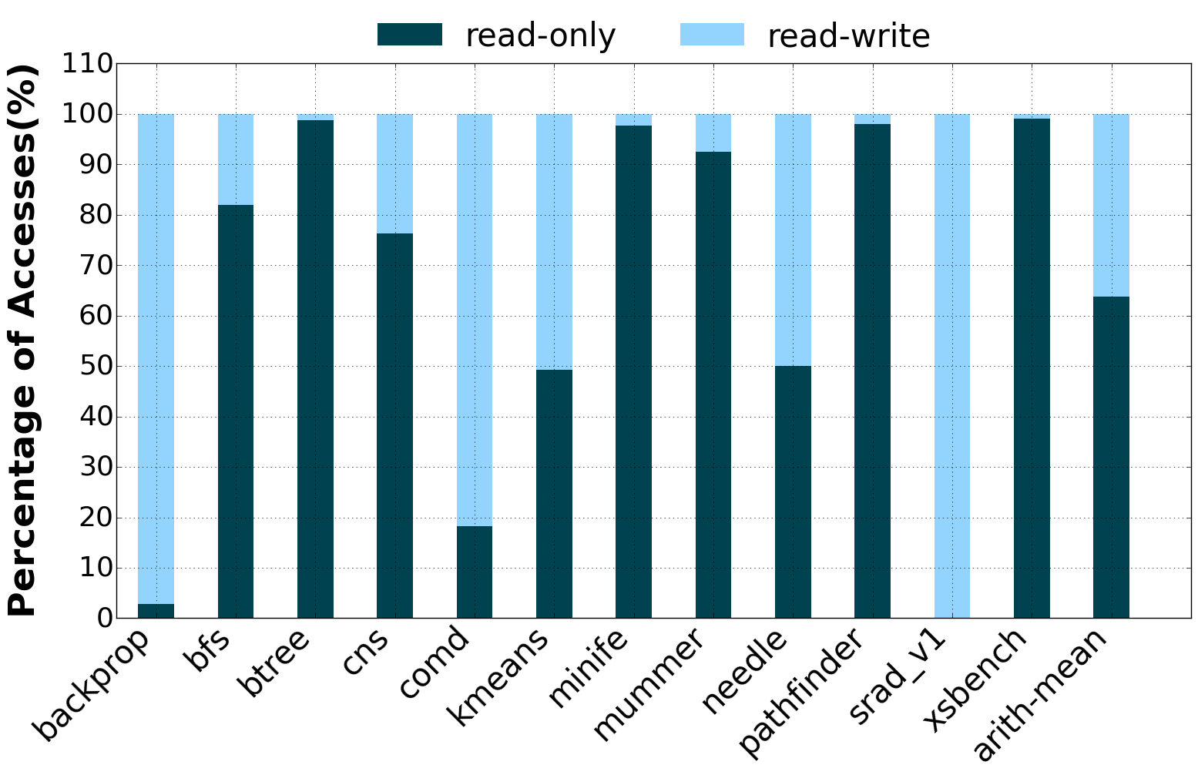
Read-only Data in GPU Applications
62% data is read-only
Notes:
The next strategy we implement has to do with read-only data. To motivate this strategy, first let us look at the breakdown of read-only vs read-write data in several GPU benchmarks.
We can observe that almost 60% of the data is read-only on an average. The benefit of having read-only data is that such data can be speculatively cached in the GPU even if they are resident on the DDR, and they can be invalidated on a write by the CPU through a software-protection based mechanism. Next, let me go into the details of this mechanism.

Slide 30
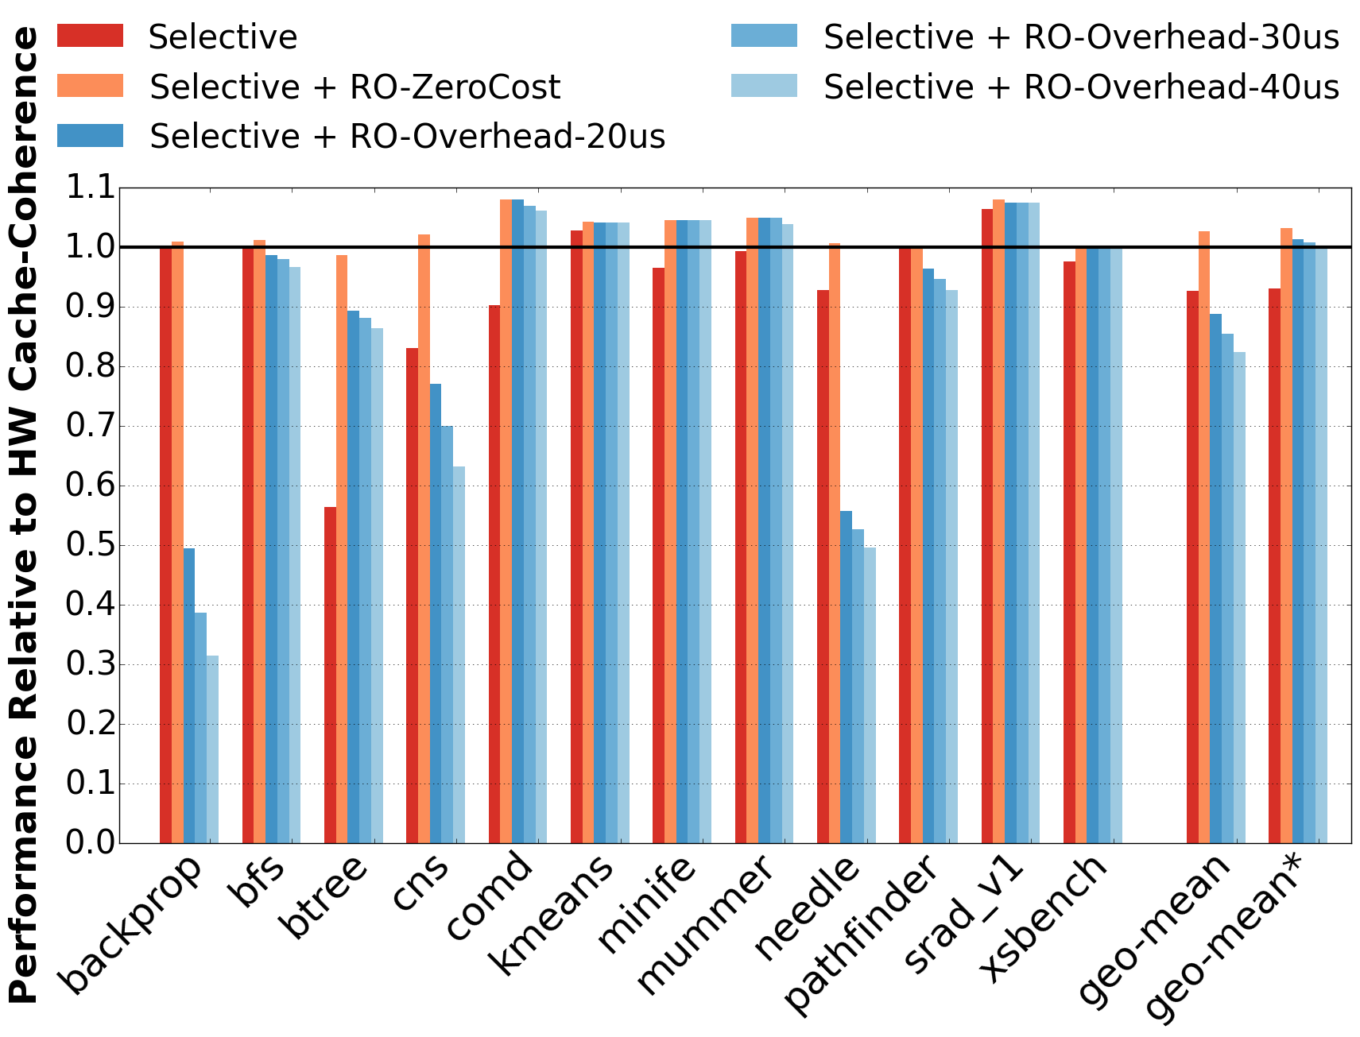
Promiscuous Read-only Caching
CPU caches all memory
GPU never caches CPU-memory
GPU caches GPU-memory if CPU not caching
v
Reduces DDR traffic from the GPU
CPUs
DDR4
Client Cache
DDR4
DDR4
Directory
DDR4
w
CPU/GPU reads DDR:
GPU caches until 1st write to the page
Improves CPU-GPU interconnect efficiency
Variable-size Transfer
CPU/GPU writes DDR:
Flush read-only pages in GPU caches
and updates page level protection
x
Provides safe caching
Read-only Cache
GDDR5
GDDR5
GDDR5
u
GDDR5
Remote Directory
GDDR5
Request Coalescer
GDDR5
GDDR5
Coalesces GPU requests to DDR
GDDR5
GPU
Notes:
In this mechanism, the both the CPU and the GPU caches all DDR-side data with read-only page protection bits. Whenever any write comes to that page, a protection fault is raised, upon which the software fault handler flushes the corresponding lines from the GPU caches, and the write bit is set on the page table entry. The GPU inspects the page protection of each page before caching it, and if it is in a read-write state, does not cache it. This software mechanism ensures that coherence is maintained, while not penalizing caching accesses to read-only lines.
In the graph on the right, we can see that read-only caching performs at-par with hardware cache coherence.
Workloads like backprop, cns, needle tend to issue many concurrent writes, exhausting the GPUs ability to overlap execution with the faults. Hence, suffer considerable slowdowns due to exposed protection fault latency. For such workloads we can disable promiscuous read-only caching in the software. Nevertheless, this mechanism can gain performance by effectively caching large fraction of read-only data present in these GPU applications.

Slide 31
Selective Caching In A Nutshell
CPU caches all memory
GPU never caches CPU-memory
GPU caches GPU-memory if CPU not caching
v
Reduces DDR traffic from the GPU
CPUs
DDR4
Client Cache
DDR4
DDR4
Directory
DDR4
w
CPU/GPU reads DDR:
GPU caches until 1st write to the page
Improves CPU-GPU interconnect efficiency
Variable-size Transfer
CPU/GPU writes DDR:
Flush read-only pages in GPU caches
and updates page level protection
x
Provides safe caching
Read-only Cache
GDDR5
GDDR5
GDDR5
u
GDDR5
Remote Directory
GDDR5
Request Coalescer
GDDR5
GDDR5
Coalesces GPU requests to DDR
GDDR5
GPU
Performance at par while simplifying coherence implementation
Notes:
So, in a nutshell we propose Selective caching with several micro-architectural enhancements to present unified view of shared virtual memory while eliminating the need to have CPU and GPU vendors agreeing on the same coherence protocol.

Slide 32
Proposal: Thermostat
Managing Huge Pages in Two-Tiered Memory in Data-centers
Notes:
As next part of my thesis I propose a system called thermostat that manages huge pages in a 2-tiered memory system catered to large footprint applications. I might have thrown some jargon here but I will describe it in a few minutes. Lets first look at the platform space we are dealing with here.

Slide 33

Data-center Memory TCO*
^{30%}
*Total Cost of Ownership [Luo DSN ’14]
Notes:
Main memory contributes to 30% of the data-center cost of ownership, which is a huge amount of money. It would be great if we can reduce this spending

Slide 34
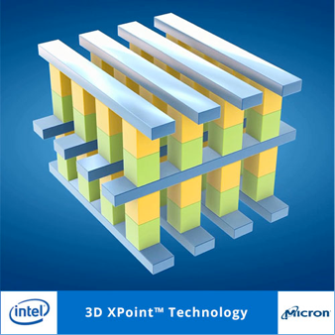
New Memory Technology < ½ DRAM Cost ~4-10x Slower than DRAM
Data-center Memory TCO*
^{30%}
*Total Cost of Ownership [Luo DSN ’14]
Notes:
Fortunately, Intel and Micron have recently announced their new memory technology called “crosspoint” that is projected to be less than half the DRAM cost that we end up paying today. However, the catch is that this memory technology is expected to be 4-10x slower than the DRAMs we use. Hence, Crosspoint will not completely replace DRAMs.

Slide 35
Goal: Increase Performance / $
Notes:
But there is definitely an opportunity to place data in this cheaper but slower memory and lower the DRAM provision in large scale data-centers to reduce the overall capital spent on main memories and thus increase performance per dollar.

Slide 36
Future Memory Hierarchy
CPU
100 ns
Fast Memory
(DRAM)
500 ns – 1us
Slow Memory
(XPoint)
Notes:
So, the future memory hierarchy we envision for data-centers is where cheaper but slower memories will be deployed along side of the DRAMs with a shared address space. CPU can directly access data from 2 different tiers of memory namely Fast DRAM and Slow Memory like crosspoint.

Slide 37
Existing Proposals: 2-Tier Memory
Paging interface to slow memory [Lim HPCA ’12]
On-demand page migration from slow to fast memory
DRAM as a cache [Jevdjic MICRO ’14, Qureshi MICRO ’12, Sim MICRO ’12]
Fast memory, invisible to OS, wastes capacity
Accounted for 4KB page size only
Notes:
2-Tier memory systems have been widely studied in the past. Those studies put infrequently accessed data in slow memory so that it doesn’t hurt performance of latency critical applications.
The first category of proposals manage slow memory as the swap device to the DRAM. Data is brought from slow memory to fast memory on-demand as application accesses memory.
The second category of proposals manage DRAM as a cache before slow memory, making it invisible to the software. Although, in such an arrangement OS doesn’t need to bother managing to separate memories, this strategy ends up wasting DRAM capacity which can be in 100s of GBs.
However, all of the past research has considered 4KB as the OS page size only.

Slide 38
What’s New With 2-Tier Memory?
Supporting Huge Pages
2MB pages instead of 4KB
Notes:
The new aspect that we want to explore with 2-tier memory is to support huge pages. The notion of having bigger page sizes was introduced by Talluri in early 1990s where instead of default 4KB, OS can manage memory at 2MB granularity. Managing memory at larger granularity has 2 advantages.

Slide 39
Huge Pages – Advantages
u Fewer TLB misses
0
4KB
8KB
Reachable by TLB
12KB
TLB
16KB
...
Out of TLB reach
8MB
Application Working Set
Notes:
First, they lead to fewer TLB misses as they are able to cover larger fraction of memory by a single TLB entry. A system with 4 TLB entries if managed at 4KB granularity can reach only 16KB of footprint without any TLB misses.

Slide 40
Huge Pages – Advantages
u Fewer TLB misses
0
2MB
4MB
Reachable by TLB
TLB
6MB
8MB
Application Working Set
Notes:
However, if instead pages are managed at 2MB granularity, same number of TLB entries can reach 8MB of footprint without causing any TLB misses.
TLB misses can hurt performance severely of applications with large working sets, hence reducing them can lead to significant perf gains as we will see in a few slides.

Slide 41
Huge Pages – Advantages
u Fewer TLB misses
Faster TLB misses
3-level tree lookup instead of 4
Better cacheability of page table entries
Notes:
Second advantage of 2MB pages is that they make every TLB miss faster. Instead of doing a 4-level tree lookup, page walk needs to be only done on a 3-level tree, which also reduces the pressure on data caches.

Slide 42
Transparent Huge Pages (THP)
Application transparent mechanism in Linux
Back large sbrk/mmap with 2MB pages
Dynamically merge contiguous 4KB pages into a huge page
Notes:
To exploit benefits of huge pages Linux provides an application transparent mechanism called Transparent Huge Pages wherein Linux allocates huge pages for large memory allocations. Applications do not need to link to any special library or statically allocate huge pages. Linux in background dynamically merges ranges of contiguous 4KB regions into 2MB regions to make 2MB pages available.

Slide 43
Huge Pages – Boost Performance
(virtualized)
Rosen (ISCA ‘16
under review)
10-40% performance gain with 2MB pages
Notes:
THP is attractive as it can give significant performance gains without needing applications changes. In our experiments, for large database applications like aerospike and redis we observe 10-15% perf gains. Under virtualization we observe perf benefit of 40% for a microbenchmark doing random probes to 8GB data.

Slide 44
BUT

Slide 45
Problem: Huge Pages in 2-Tier Memory
Reduces fraction of cold data to be put into slow memory
Expensive to migrate data at 2MB granularity
Notes:
What is cold data?

Slide 46
Cold Data Slow Memory
Identified cold data at runtime using “kstaled” in Linux kernel
~50% of cold 4KB pages can go to slow memory

Slide 47
Cold Data Slow Memory
Cold page fraction reduces from 50% to 15%
Notes:
drastic reduction in the number of pages that are idle for the same time duration

Slide 48
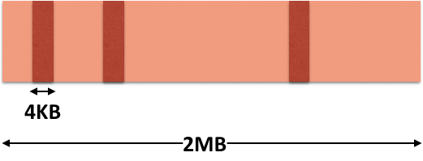
Problem: HotSpots in Cold Huge Pages
Separate 4KB hot pages within 2MB huge page

Slide 49


Slide 50
Thermostat – Make Slow Memory Usable in Data-centers
Detect cold pages
Hot spots in otherwise cold huge pages
Multiple page mappings to fast and slow memory

Slide 51
Identifying HotSpot Huge Pages
Online sampling mechanism

Slide 52
Identifying HotSpot Huge Pages
HotSpot Huge Page
Cold Huge Page
Hot Huge Page
Online sampling mechanism

Slide 53
Identifying HotSpot Huge Pages
CPU
100 ns
Hot Huge Page
HotSpot 4KB
Hot Huge Page
Fast Memory
(DRAM)
HotSpot Huge Page
Cold Huge Page
Hot Huge Page
500 ns – 1us
Cold + HotSpot
Huge Page
Cold Huge Page
Slow Memory
(3D X Point)
Online sampling mechanism

Slide 54
Distribution of Cold Data in Cassandra
100
Hot
Huge Pages
80
60
HotSpot
Huge Pages
Fraction of 2MB pages (%)
40
Cold
Huge Pages
20
0
0
20
40
60
80
100
Fraction of 4KB pages within 2MB huge page (%)
Several hotSpot pages in an application
Notes:
Font size of the graph also divide up the pages

Slide 55
Multiple Memory Mappings
Have 2 valid mappings for a page
4KB mapping and 2MB mapping
If valid use 2MB mapping, else fetch the 4KB mapping
Lookup TLB
4KB TLB
Bit vector to validate 2MB mapping
...
2MB TLB

Slide 56
Next Expedition
Can we reduce memory cost while satisfying perf. goals?
Exploit performance benefits of huge pages in 2-tier memory?
Application transparent detection of cold pages at runtime?
Can multiple mappings keep hot 4KB pages in fast DRAM?

Slide 57
Timeline
Defense
December ’15
Framework
Online detection of hotspot pages
January – February ’16
Policy Exploration:
Paging vs load/store interface
Replacement/Migration
March – April ’16
Performance Evaluation
Impact: slow memory latency
Memory saving analysis

Slide 59
Simulation Environment
Simulator: GPGPU-Sim 3.x
Heterogeneous 2-level memory
GDDR5 (200GB/s, 8-channels)
DDR4 (80GB/s, 4-channels)
GPU-CPU interconnect
Latency: 100 GPU core cycles
Workloads:
Rodinia applications [Che’IISWC2009]
DoE mini apps [Villa’SC2014]
100 clks additional latency
GPU
CPU
80 GB/s
200 GB/s
80 GB/s
GDDR5
DDR4

Slide 60
Dynamic Page Migration
Static Oracle
CHANGE GRAPH
6% better than Legacy CUDA
Notes:
Nevertheless
change the graph

Slide 61
Evolving GPU Memory System
NVLink
(Cache Coherent)
GDDR5
GPU
PCI-E
CPU
DDR4
80 GB/s
200 GB/s
15.8 GB/s
80 GB/s
CUDA 1.0-5.x
CUDA 6.0+: Current
Future
Roadmap
cudaMemcpy
Programmer controlled copying to GPU memory
Unified virtual memory
Run-time controlled copying →
Better productivity
CPU-GPU cache-coherent
high BW interconnect
How to best exploit full BW while maintaining programmability?
Notes:
Let me first take you through the evolution of GPU memory system via a roadmap.
A typical CPU-GPU system today is connected by a PCI-E link. The GPU is connected to high bandwidth GDDR memory and CPU is connected to high-capacity but lower-bandwidth DDR memory.
Example system
In the legacy systems from first generation of CUDA uptill CUDA 5, programming model was such that GPU could only access the GDDR memory attached to it. Programmer was responsible to identify the data accessed by the GPU and manually transfer it to the GDDR memory using cudaMemcpy calls. Such a programming model demands high effort on part of the programmer.
Moving forward CUDA 6.0 onwards Unified virtual memory was introduced, wherein the programmer is no longer required to make explicit data copies. Using the same hardware as in the legacy systems runtime software performs on-demand data copying to the GPU memory. Although this memory abstraction had a significant impact on improving programmer productivity still on-demand copying slows down the running program.
Moving further ahead, we anticipate that CPU & GPU will become cache coherent. As announced by the GPU vendors CPU & GPU will be connected via a high BW interconnect such as NVIDIA’s NVLink. For the first time GPU will be able to transparently access the CPU memory. This future system provides various opportunities for performance enhancement as GPU can now use BW from both CPU and GPU memories. The big question here is how to exploit the full system BW in the best possible way without burdening the programmer to worry about the data placement or copying decisions.
Goals:
Simple programming model
Exploit full DDR + GDDR BW

Slide 62
BW Maximization Policies
BW-AWARE Placement
Place pages in the ratio of memory bandwidths
Application agnostic policy
Dynamic Page Migration
Aggressively migrate pages upon First-Touch to GDDR memory
Pre-fetch neighbors of touched pages to reduce TLB shootdowns
Throttle page migrations when nearing peak BW
Notes:
In this work, we have developed intelligent dynamic page migration policies that demands no programmer involvement. We aggressively migrate pages to the GDDR memory after a page has been accessed. We employ a technique to pre-fetch neighbors of already accessed pages to reduce TLB shootdowns. Finally, we throttle page migrations when BW utilization peaks as more migration lead to under-utilization of the CPU memory BW.
Our dynamic page migration policy performs 1.95 times better than no migration case, is within 28% of the static oracle performance and is 6% better than the Legacy CUDA.

Slide 63
GPU Workloads: Memory Latency Tolerant
Applications are more sensitive to memory bandwidth than latency
Notes:
CHANGE GRAPH: put same y-axis scale as the last slide
However, we observed that most of these workloads are tolerant to memory latency.
Explain the graph
All except one are tolerant to memory latency
Hence, we can see that memory bandwidth is much more important for GPU performance than the latency.

Slide 64
GPU Bandwidth Utilization
Total System Memory BW
280
GPU
NVLink
CPU
80 GB/s
200
GPU Memory BW
Total Bandwidth (GB/s)
200 GB/s
80 GB/s
80
Additional BW from CC
GDDR5
DDR4
0
100
% of Pages in GPU Memory
Coherence-based accesses, wastes GPU memory BW
Notes:
CHANGE FIGURE: Remove CPU from the figure
Let's look at how to maximize memory bandwidth to the GPU in a heterogeneous memory system.
On the left, we have a system where GPU has its own high bandwidth GDDR memory attached to it. It is also connected to the CPU-attached DDR memory through a high bandwidth cache-coherent interconnect such as NVLink ,which enables it to directly access the DDR memory.
On the right, we see the total bandwidth available to the GPU as we vary the fraction of data placed in these memories.
When all the data is only in DDR memory the available BW is only from the cache coherent interconnect which is 80GB/sec. Clearly, this wastes all of the GDDR memory bandwidth
Now, let us look at the BW utilization as we start running an application on this system. On the left we will see how GPU accesses the data from the memory system and on the right we will see the BW utilization for those accesses.
For the sake of the programmability, all the data is allocated in the CPU memory to begin with. GPU can access this data from the CPU memory via cache coherence. Hence, the best BW utilization in such topology can be only 80GB/s, which is only 30% of the total system BW. We are not able to use 70% of the system BW which a a big lose from performance perspective.
With no page migrations this system will end up wasting high BW GPU memory.
Next, we move onto the future CC-NUMA system where CPU and GPU are connected through a high BW interconnect of 80GB/s. For the sake of programmability all the data structures reside in the CPU memory to start with. GPU can do coherence-based accesses and thus the total BW utilizes in this system will be 80GB/s. Clearly, with no page migration enabled from DDR to GDDR memory this system will end up wasting high BW GPU memory.

Slide 65
GPU Bandwidth Utilization
Total System Memory BW
280
GPU
NVLink
CPU
80 GB/s
200
GPU Memory BW
Total Bandwidth (GB/s)
200 GB/s
80 GB/s
80
Additional BW from CC
GDDR5
DDR4
70
0
100
% of Pages in GPU Memory
Bandwidth-Aware Placement
Place data in the ratio of memory bandwidths
Notes:
Remember, our goal here is to reach the peak BW as soon as possible. As pages are migrated to the GPU memory BW utilization will go up. We have observed that the best bandwidth utilization happens when the application data is spread across the GDDR and DDR memories in the ratio of their bandwidths. In our ASPLOS 2015 paper we will discuss more about the static placement policies. The goal of this work however is to dynamically migrate pages so that data is divided in the ratio of memory BW and thus GPU can concurrently access both the memories.
Distinguish ASPLOS from HPCA
Correct animation
How can we utilize both the CPU and the GPU memory BW? In our ASPLOS 2015 paper we will discuss about the static oracle placement that achieves the goal of maximizing BW utilization from both the memories. By placing data in the ratio of memory BW here it being 70:30% GPU can saturate both the memories and thus achieve the cumulative BW of 280GB/s. The goal of this work is to achieve this static oracle performance by dynamically migrating pages among DDR and GDDR memories.

Slide 66
GPU Bandwidth Utilization
Total System Memory BW
280
GPU
NVLink
CPU
80 GB/s
200
GPU Memory BW
Total Bandwidth (GB/s)
200 GB/s
80 GB/s
80
Additional BW from CC
GDDR5
DDR4
70
0
100
% of Pages in GPU Memory
Excessive data in GDDR leads to under-utilization of DDR BW
Notes:
As more and more migration happen, a point comes where all the data is transferred to the GPU memory. In such a case GPU memory requests can only be served from GDDR memory. Excessive page migration leads to under-utilization of the CPU memory BW. Hence page migration policy should only migrate pages to unlock memory BW of both the DDR and the GDDR memories.
So, the take away from the above discussion is that we want to utilize both 200GB/s from GDDR memory and 80GB/s from DDR memory at the same time we do not programmer to worry about these decisions.
Let us try to understand how BW is utilized in the Legacy/Current CPU-GPU systems where either programmer/SW runtime copies data accessed by the GPU to the GDDR memory.
On the left we can see a GPU attached to the CPU through low BW PCI-E link. Any data accessed by the GPU has to be placed in the GDDR memory as this system is not CC, which means that DDR BW will not be used by the GPU. All the GPU accesses happen through 200GB/s attached memory. Therefore, the total BW utilization of this topology can be 200GB/s.

Slide 67
Conclusion: CPU-GPU Systems
BW-AWARE placement maximizes GPU bandwidth utilization
Dynamic page migration: performance with programmability
Selective caching simplifies unified shared memory
Decouples vendor-specific coherence protocols
Notes:
In summary, for a GPU heterogeneous memory systems I have proposed bandwidth maximizing placement and migration policies policies. We have also talked about selective

Slide 68
Multiple Memory Mappings
Have 2 valid mappings for a page
4KB mapping and 2MB mapping
Bit vector to validate 2MB mapping
...
If valid use 2MB mapping, else fetch 4KB mapping from memory

Slide 69
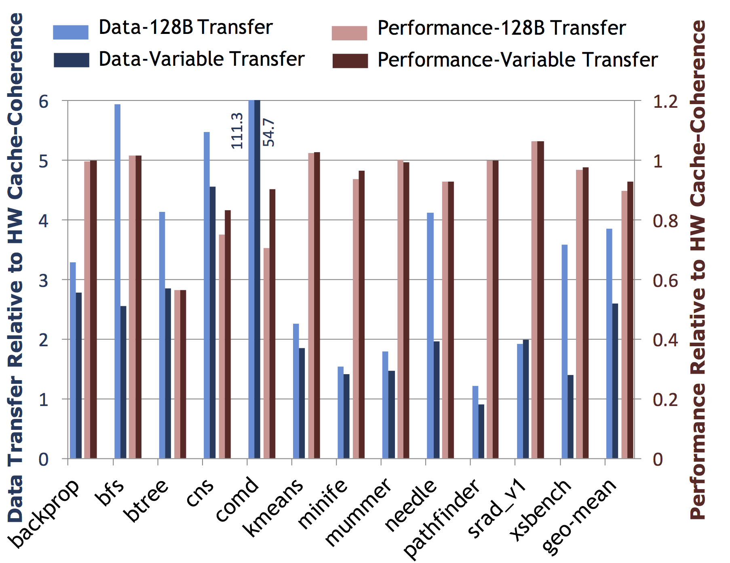
Variable Width Request Transfer
CPU caches all memory
GPU never caches CPU-memory
GPU caches GPU-memory if CPU not caching
v
Reduces DDR traffic from the GPU
CPUs
DDR4
Client Cache
DDR4
DDR4
Directory
DDR4
GPU reads DDR:
DIR sends most recent copy
w
GPU writes DDR:
DIR handles invalidation of CPU caches
Improves CPU-GPU interconnect efficiency
Variable-size Transfer
CPU reads/writes GDDR:
Line inserted in Remote Directory (Filter) GPU can’t cache lines found in this filter
GDDR5
GDDR5
GDDR5
u
GDDR5
Remote Directory
GDDR5
Request Coalescer
GDDR5
GDDR5
Coalesces GPU requests to DDR
GDDR5
GPU
93% performance
Notes:
On the right we now show the amount of data sent over the CPU-GPU interconnect and also its performance compared to the case where full sized transfers are done. We can see that while the performance impact of variable request transfer is not very high, variable request transfers do reduce the amount of data transferred by ~35%.

Slide 70
GPU Workloads: Memory Latency Tolerant
140
160
170
185
200
215
230
240
255
270
285
Applications are more sensitive to memory bandwidth than latency
Notes:
However, we observed that most of these workloads are tolerant to memory latency.
Explain the graph
Hence, we can see that memory bandwidth is much more important for GPU performance than the latency.

Slide 71

Reduce Data-center Memory TCO && Service Level Guarantees

Slide 72
Huge Pages – Boost Performance
10-40% performance gain with THP
Rosen (ISCA ‘16 under review)
Notes:
THP – Available today in Linux kernel
Regular OS pages: 4KB, Huge pages: 2MB
Put in the performance graph for your numbers and cite Jeff’s paper

